Slide 1
Formula1
Presentation by: Vignesh, Vinay, Shah, Rama and Sunanda
Mentor: Mothanna

Slide 2


Why Formula 1?
The sport
The cars
Extremely data driven sport
Data analytics used and influences:
Car design
How cars are driven
How the race is aired on media
Pinnacle of automobile technology
Over 200 sensors
300GB+ of data over one race
Notes:
Car vector created by freepik - www.freepik.com

Slide 3
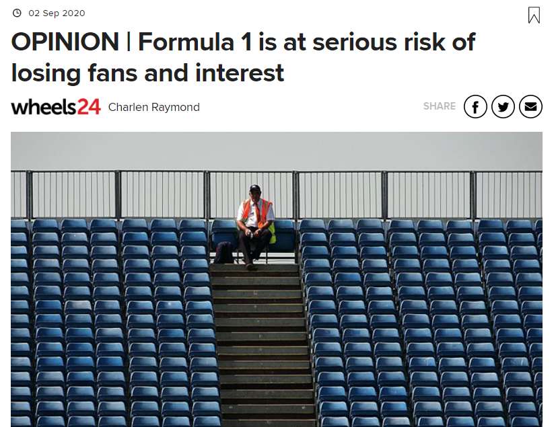
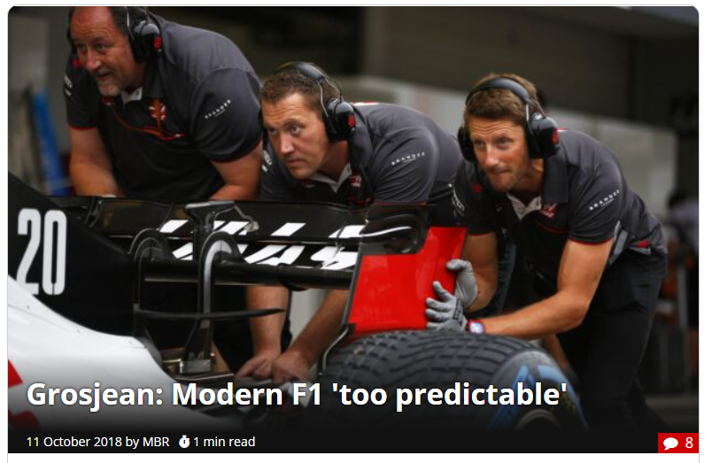
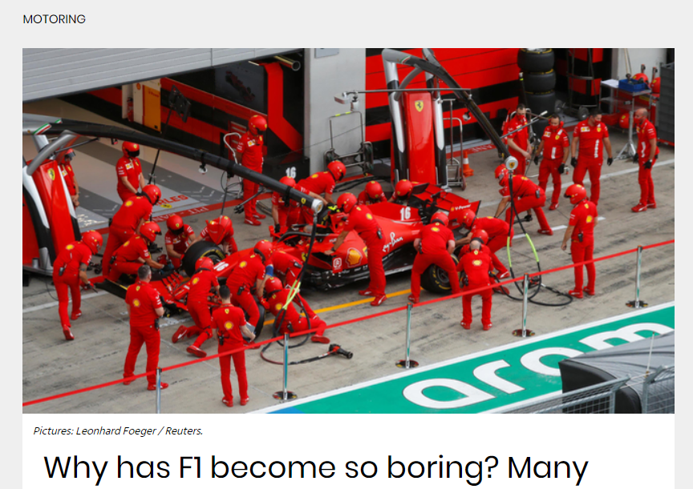
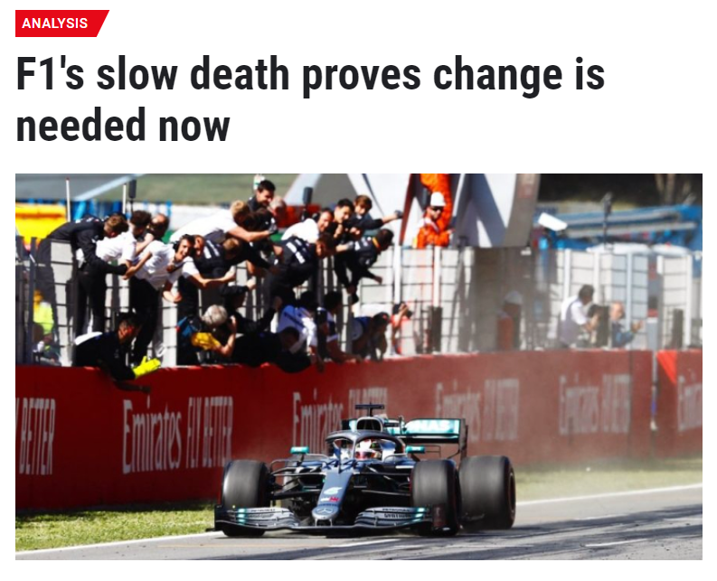
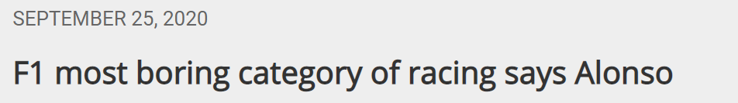
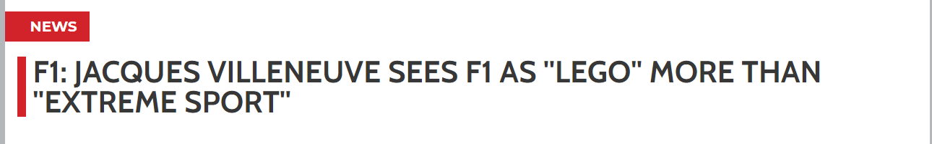
But...F1 is boring! And too predictable...

Slide 4
Data sources and project data flow
Kaggle F1 dataset
JavaScript+HTML web dashboard
Postgres Database on AWS RDS
Data Analysis & ML models
Data transformations (ETL)
Web scraping of weather data
Tableau storyboard

Slide 5
Questions we wanted to answer
Is it true? Is F1 too predictable?
Can we use ML models predict race winners for each race in one season based on historical data?
Can we use ML models to predict race finish positions(in buckets) for each race in one season?
Can we come up with race-level strategies by segmenting races into different buckets?

Slide 6
Data exploration - answered the following questions
What data is available?
How is the data linked across tables?
Entity Relationship Diagram to map relations
What analysis should we do to get us closer to answer the questions?
What data should be cleaned?
What data wrangling is to be done?
How do we join data from different sources?
Identifying quantitative, categorical variables - need to be transformed for ML?
Which data is unnecessary and can be dropped?

Slide 7
Data Analysis
Driver trends
Race winning drivers
Home-race advantage?
Does qualifying matter? Are starting grid position and final position correlated?
Constructor trends
Race winning constructors
Track altitude v/s constructor advantage
Pitstop times v/s points won
Circuit trends
First lap position v/s final position
Fifth lap position v/s final position
Circuit speeds using Fastest lap speeds
DidNotFinish analysis

Slide 8
Technologies and tools used
Python
Pandas for data wrangling and ETL
Scikit learn for machine learning models
Matplotlib and Seaborn for visualizations
Tableau public for visualizations and storyboarding
Javascript, d3.js and HTML for web dashboard
MS-Excel for data exploration
PostgreSQL for backend database
AWS RDS for cloud database hosting
Github for version control and project collaboration
Slack for team communication
Google suite for documentation
StackOverflow for... well, pretty much all of the above!

Slide 9
Machine Learning Models used
Supervised learning
Logistic regression
Support Vector Machines (SVM)
Random Forest Classifier
Neural Networks
Unsupervised learning
KMeans clustering
Hierarchical clustering

